Slide 1
Deep Learning and Computer Vision
Applied AI, 6COSC020W
Aleka Psarrou

Slide 2
Acknowledgements
This material has been put together using multiple sources from WWW and slides from colleagues in the field.
Main sources of material:
CS231n: Convolutional Neural Networks for Visual Recognition
http://cs231n.stanford.edu/schedule.html
MIT 6.S191 Introduction to Deep Learning
Deep Learning and Computer Vision, Queen Mary, University of London
Convolutional Neural Networks
https://medium.com/@eltronicsvilla17/convolutional-neural-network-1a02f472a90c

Slide 3
Deep Learning and Computer Vision
Why is computer vision important?
What computers see?
How are features created and used in image representation
What is deep learning?
How can deep learning (convolutional networks) help
Why deep learning now
Some deep learning (CNN) architectures

Slide 4
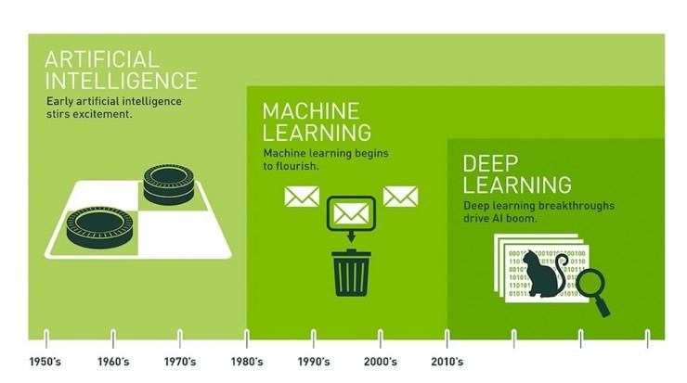
What is Deep Learning?

Slide 5
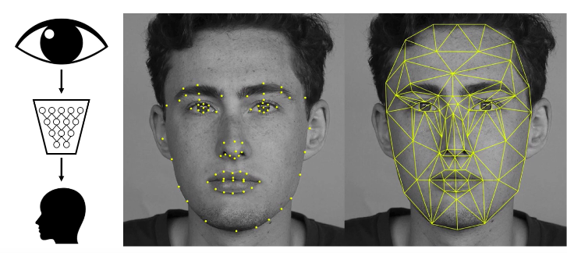
Face recognition
6.S191 Introduction to Deep Learning, MIT

Slide 6
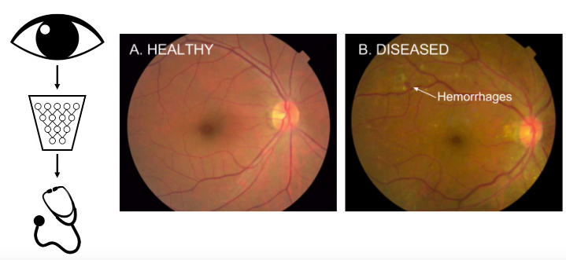
Detecting haemorrhages in retinas
6.S191 Introduction to Deep Learning, MIT

Slide 7

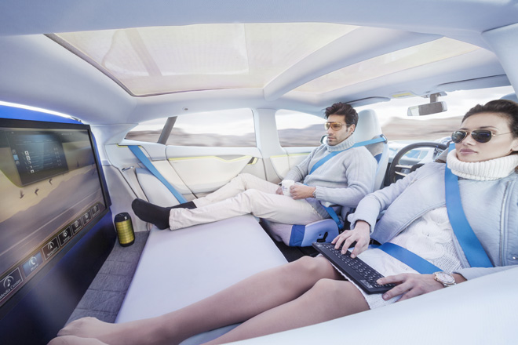
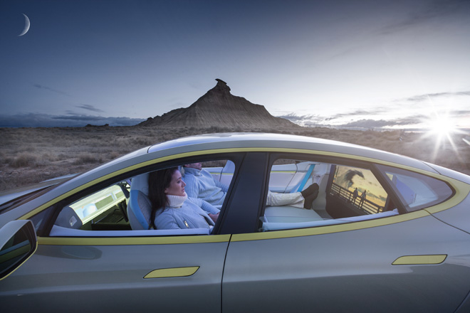
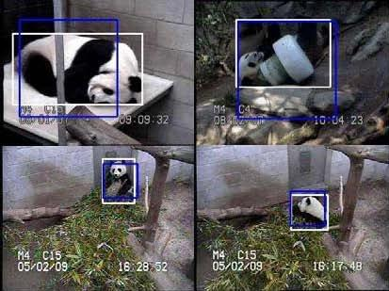
Why is object detection important?
Perception is one of the biggest bottlenecks of
Robotics
Self-driving cars
Surveillance
Queen Mary, University of London
Notes:
Perception is a big deal and is currently one of the biggest bottlenecks for applications such as robotics, self driving cars or surveillance (pandas only).

Slide 8
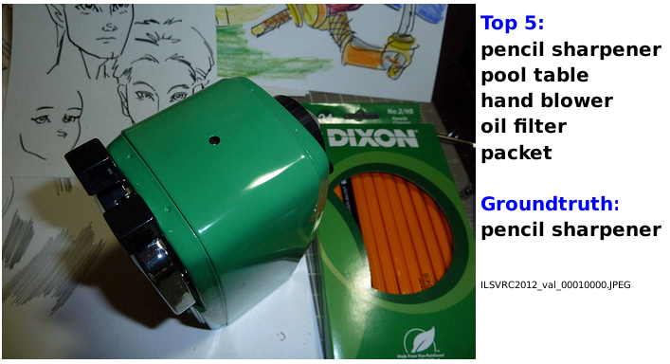
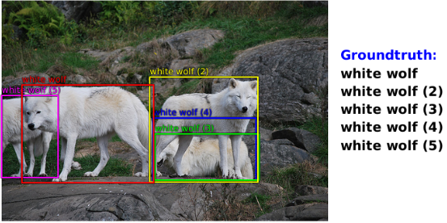
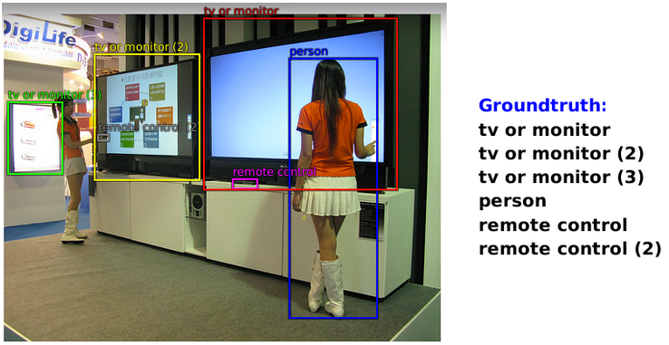
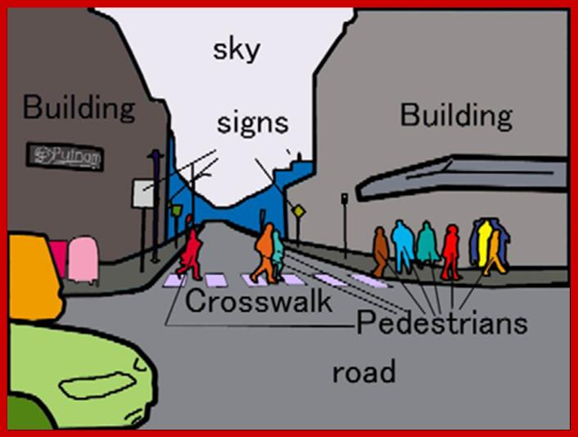
What is object detection?
classification
localization
detection
segmentation
difficulty
Queen Mary, University of London
Notes:
I’ll first define object detection from a computer vision perspective with respect to other tasks such as classification which usually assumes predicting the class of the main object of an image, localization where you have to predict the class of the main object but also a tight bounding box around it. Now detection is similar to localization except that objects can be of any size and in any number (including zero). Segmentation goes one step beyond by labeling every pixel of an image. These are ordered by increasing difficulty, and you probably don’t need to go all the way to segmentation for many tasks.

Slide 9
What Computers See

Slide 10
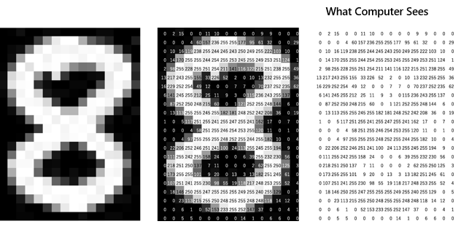

Slide 11
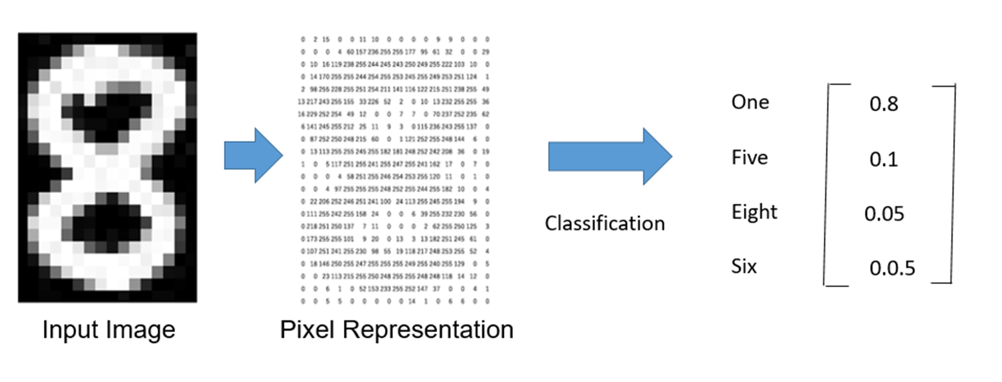
Image classification
0.05
0.15
0.7
0.1

Slide 12
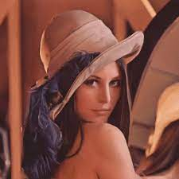
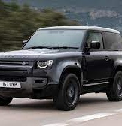
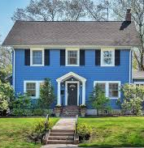
Features are characteristic for each class
Nose,
Eyes,
Mouth
Wheels,
Number Plate
Headlights
Door,
Windows
Steps

Slide 13

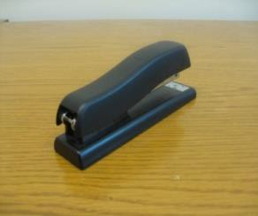
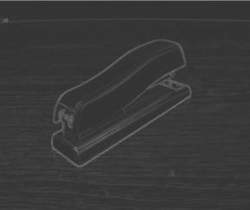

Traditional Recognition Approach
feature representation (hand-crafted)
Learning Algorithm (e.g., SVM)
Input data (pixels)
Features are not learned
Image
Low-level vision features
(edges, SIFT, HOG, etc.)
Object detection
/ classification

Slide 14
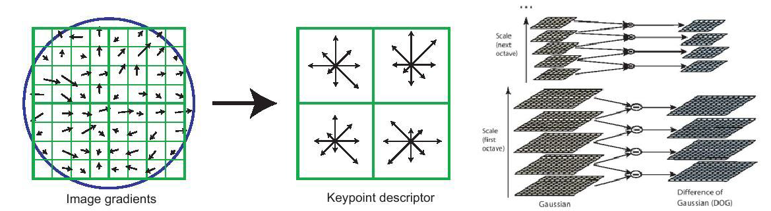
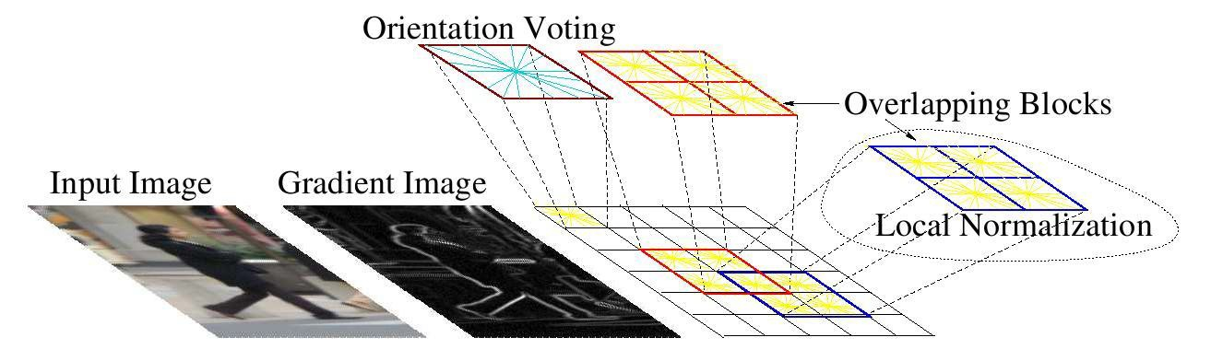
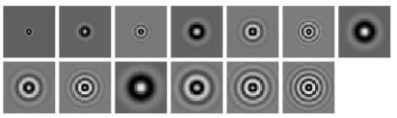
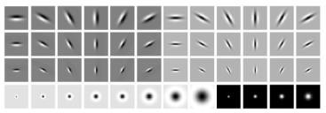
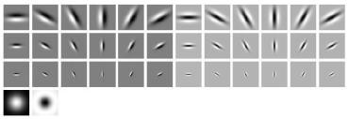
Computer vision features Low level representations
SIFT
Textons
HoG
and many others:
SURF, MSER, LBP, Color-SIFT, Color histogram, GLOH, …..

Slide 15
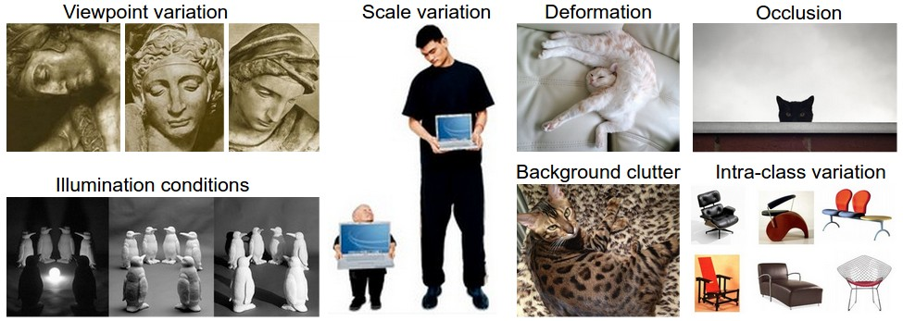
Manual Feature extraction

Slide 16
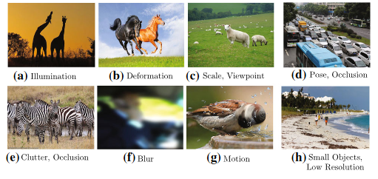
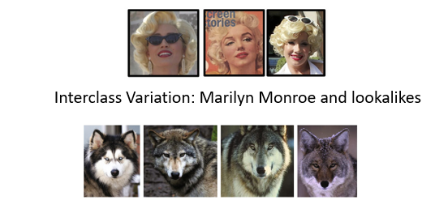
Intraclass and Interclass variations
Interclass variation: Species of animals who look similar but in fact, are from four different object classes

Slide 17
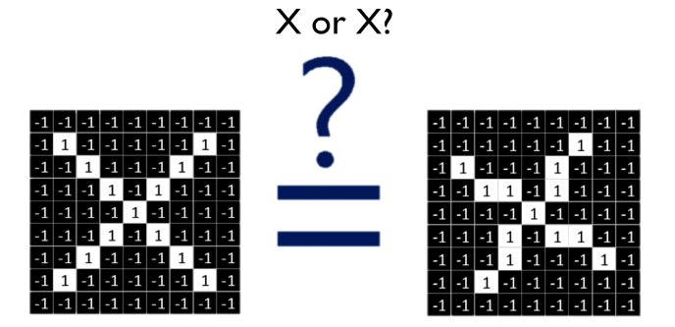
Feature Detection and Convolution: A case study

Slide 18
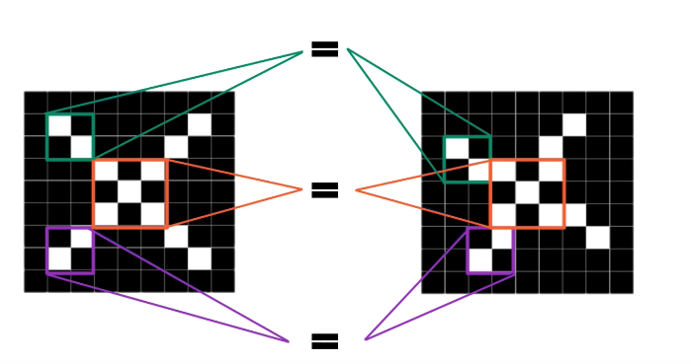
Features of X

Slide 19
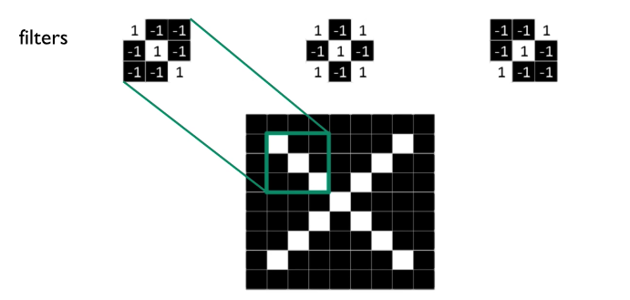
Filters to detect Features of “X”

Slide 20
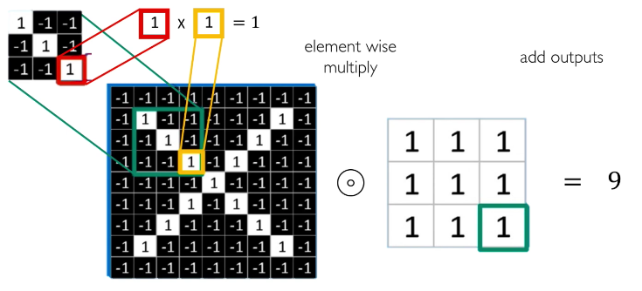
The convolution operation

Slide 21
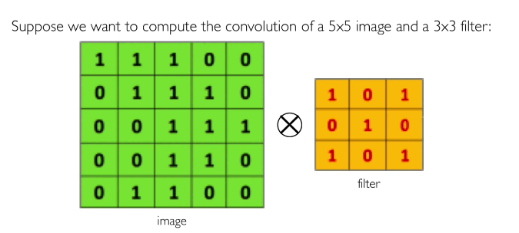
The convolution operation

Slide 22
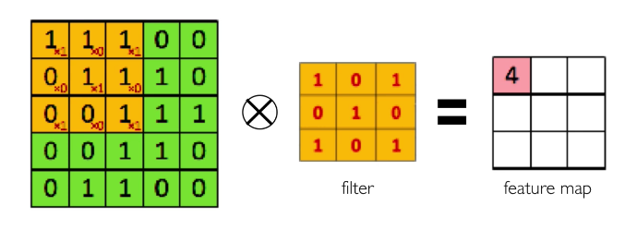
The Convolution operation

Slide 23
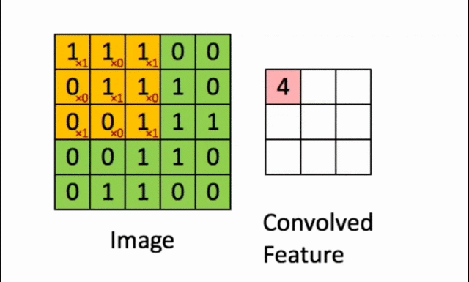
The Convolution operation

Slide 24
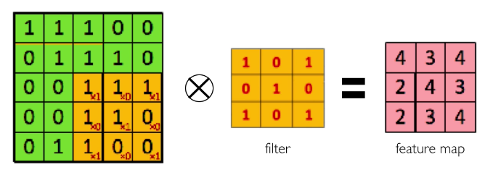
The Convolution operation

Slide 25
Filters to detect Features of “X”

Slide 26
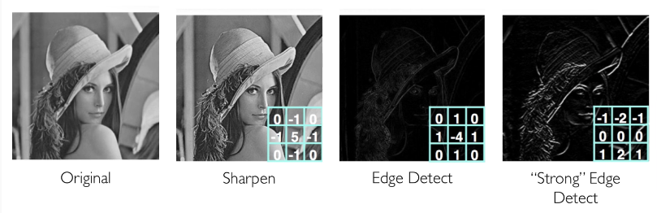
Examples od edge detection filters

Slide 27
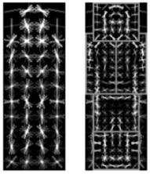
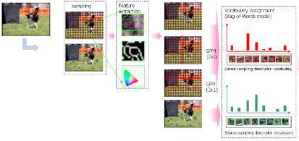

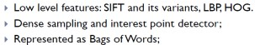
Motivation for Computer vision and Deep learning
Features are key to recent progress in recognition
Multitude of hand-designed features currently in use
Where next? Better classifiers? building better features?
Felzenszwalb, Girshick,
McAllester and Ramanan, PAMI 2007
Yan & Huang
(Winner of PASCAL 2010 classification competition)
Slide: R. Fergus

Slide 28
Performance of computer vision algorithms
Performance
Traditional Learning Algorithm
Data
Where next? Better classifiers? building better features?
Difficult to hand-engineer features -> What about
learning them?

Slide 29
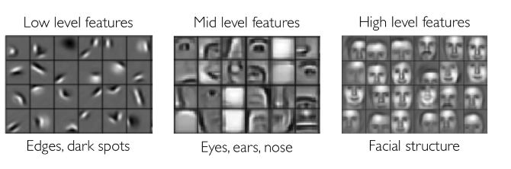
Features Hierarchy

Slide 30
Learning Visual Features

Slide 31








Learning Feature Hierarchy
Learn hierarchy
All the way from pixels -> classifier
One layer extracts features from output of previous layer
Image/Video Pixels
Simple
Classifier
Layer 1
Layer 2
Layer 3
Train all layers jointly
Slide: R. Fergus

Slide 32
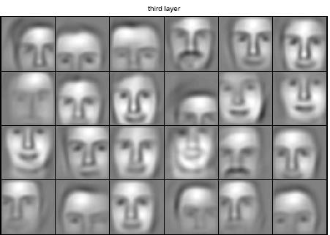
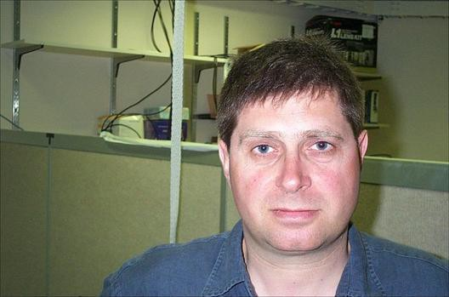
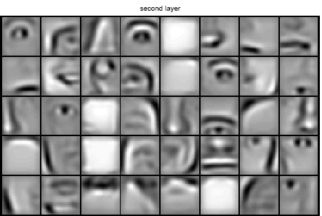
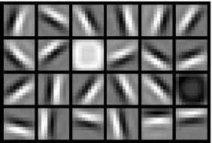
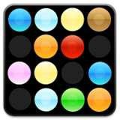
Learning Feature Hierarchy
1. Learn useful higher-level features from images
Feature representation
3rd layer “Objects”
Input data
2nd layer “Object parts”
1st layer “Edges”
Lee et al., ICML 2009; CACM 2011
Pixels
2. Fill in representation gap in recognition

Slide 33
Approaches to learning
Supervised Learning
End-to-end learning of deep architectures (e.g., deep
neural networks) with back-propagation
Works well when the amounts of labels is large
Structure of the model is important (e.g.
convolutional structure)
Unsupervised Learning
Learn statistical structure or dependencies of the data from unlabeled data
Layer-wise training
Useful when the amount of labels is not large

Slide 34
How we detect features - image convolution

Slide 35
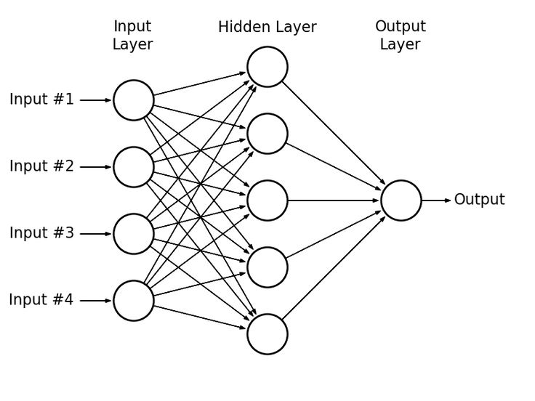
How we learn end to end? Neural Networks

Slide 36
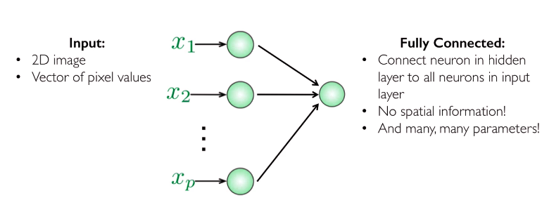
Limitations of Fully Connected NNs for object detection

Slide 37
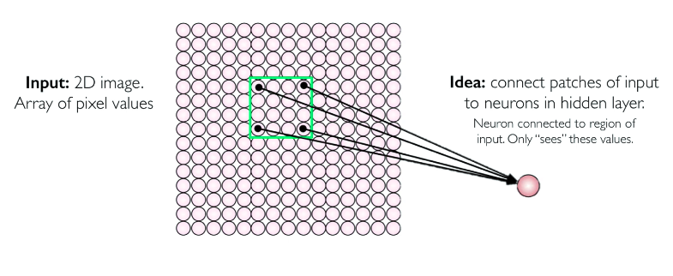
Using spatial structure

Slide 38
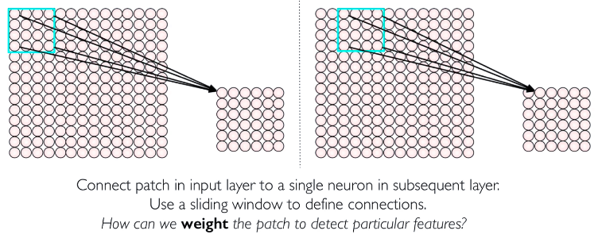
Using spatial structure

Slide 39
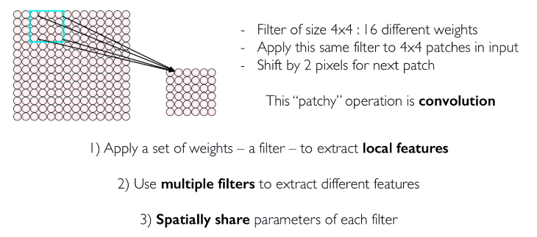
Learn the weights through convolution & back-propagation

Slide 40
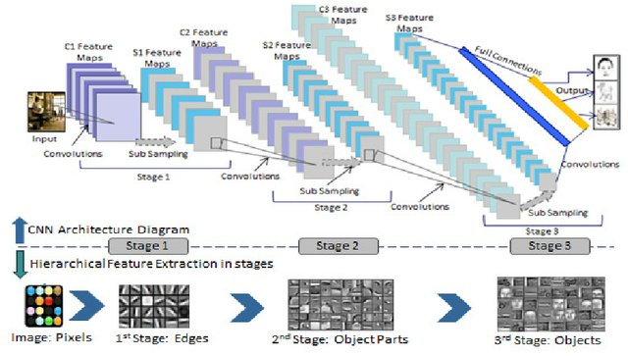
CNN and Features Hierarchy

Slide 41
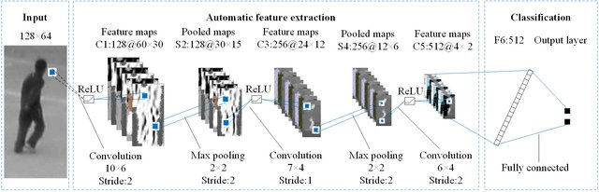
Automatic Feature extraction and Classification

Slide 42

CNNs for classification

Slide 43

Convolutional Layers: Local Connectivity
For a neuron in hidden layer:
Take inputs from patch
Compute weighted sum
Apply bias

Slide 44

Convolutional Layers: Local Connectivity
4x4 filter: matrix
of weights w_{ij}
For a neuron in hidden layer:
Take inputs from patch
Compute weighted sum
Apply bias
$\sum_{i=1}^{4}{\sum_{j=1}^{4}{\text{w}\text{ij} }}$x_{i+p,j+q} +b
For neuron (p,q) in hidden layer
Applying window for weights
Computing linear combinations
Activating with non-linear function

Slide 45




Convolutional layer

Slide 46


Convolutional layer – two filters

Slide 47

Notes:
Poll Title: Do not modify the notes in this section to avoid tampering with the Poll Everywhere activity. More info at polleverywhere.com/support How many parameters are in the first convolution layer of a CNN that is trained using 50 x 50 RGB images and 8 filters of size 5 * 5? https://www.polleverywhere.com/multiple_choice_polls/HOTPgziAsI2P2YktiCwtE?state=opened&flow=Default&onscreen=persist

Slide 48


CNNs: Spatial arrangement of output volume
depth
Layer Dimensions:
h x w x d
h, w are spatial dimensions
d(depth) = number of filters
Stride: Filter step size
Receptive field: Locations in input image
that a node is path connected to
height
width

Slide 49


Introducing non-linearity - ReLU
Apply after every convolution operation (i.e. after
convolutional layers)
ReLU: pixel by pixel operation that replaces all negative
values by zero. Non-linear operation.
Rectified Linear Unit (ReLU)
g(z) = max(0,z)

Slide 50


Pooling

Slide 51
Learning Features Hierarchy in CNNs
Conv Layer 1
Conv Layer 2
Conv Layer 3

Slide 52

Learning Feature Hierarchies

Slide 53

Notes:
Poll Title: Do not modify the notes in this section to avoid tampering with the Poll Everywhere activity. More info at polleverywhere.com/support What do feature maps represent in a convolutional neural network? https://www.polleverywhere.com/multiple_choice_polls/ver8qBX3jW476f6XJMv8D?state=opened&flow=Default&onscreen=persist

Slide 54

CNNs for Classification: Feature Learning & Class Probabilities
Convolution: Apply features to generate feature maps
Non-linearity: Often use ReLU
Pooling: Downsampling operation on each feature map
CONV and POOL layers output high level features of input
Fully connected layer uses these features for classifying input image
Express output as probability of image belonging to a particular class

Slide 55

CNN – Example car classification

Slide 56




History of ConvNets
Fukushima 1980
Neocognitron
Rumelhart, Hinton, Williams 1986
“T” versus “C” problem
LeCun et al. 1989-1998
Hand-written digit reading
...
Krizhevksy, Sutskever, Hinton 2012
ImageNet classification breakthrough
“SuperVision” CNN
slide: Girshick
Notes:
Now a very quick history of ConvNets, it started in the 80s, Yann made them work in the 90s, then toronto scaled them up 2 years ago.

Slide 57
CNN Architectures
Best known
VGG
Efficient nets
Also..
SENet
WideResNet
GooLeNet
ResNet
MobileNets
EfficientNet
SuffleNet
DenseNet
NasNet
AlexNet

Slide 58


Slide 59


Slide 60


Slide 61

The two have the same effective receptive field (7x7)
A single 7x7 filter has parameters proportional to 49
A triple 3x3 stack has parameters proportional to 3x(3x3) = 27

Slide 62


Slide 63


Slide 64


Slide 65


1 x 1 Convolutions

Slide 66


Slide 67


Slide 68


Slide 69


Slide 70


Slide 71


Slide 72


Slide 73


Slide 74


Slide 75


Slide 76


Slide 77






Deep Networks – Tricks of the trade – activation function
sigmoid(x) = 1/ (1+e^{-x} )
- Squashes numbers to range [0,1]
- Historically popular
- Saturated neurons “kill” the gradients
- Sigmoid outputs are not zero-centered – gradients in same direction
- Expensive to compute
Sigmoid
tanh(x) = e^{x} – e^{-x}/ e^{x} –+e^{-x}
- Squashes numbers to range [1,-1]
- Saturated neurons “kill” the gradients
- Zero centered
ReLU (Rectified Linear Unit)
relu(x) = max (0,x)
- Does not saturate (in + region)
Converges much faster in practice (6x)
Computationally efficient
- Not zero-centered

Slide 78






Deep Networks – Tricks of the trade
Data Initialisation
Weight Initialisation
Depends on
- number of connections to hidden unit
- activation function of units
Regularisation

Slide 79

Deep Networks – Tricks of the trade

Slide 80

Deep Networks – Main Takeaways

Slide 81


CNN Key Concepts
Architecture
Convolution
Activation function as ReLU (rectified linear unit)
Sparsely connected (vs. fully connected MLP multi-layer perceptron)
Going deep – replicating feature responses
Pooling multi-responses (max-pooling, mean-pooling)
Model training
Feedforward: Compute & propagate feature representations
Backpropagation: Compute & propagate gradients of error functions
Optimisation: Gradient descent and stochastic gradient descent (SGD)
Dropout (randomised repetition to minimise overfit)
Data augmentation (minimise overfit)
Mini-batches per epoch (random sampling a training set)
Many epochs (re-visiting the same training set in different ways)
Going deep

Slide 82

Main CNN Architectures

